Slide 1

ATTENDANCE USING FACIAL RECOGNITION
GUIDE NAME:
KAVERI AP/CSE
PRESENTATION BY:
S.GOWTHAM
T.SHARAN
M.VIGNESH

Slide 2
INTRODUCTION:
Facial recognition-based attendance systems have become increasingly popular in a variety of settings, including educational institutions, corporate offices, and even events
Facial recognition attendance systems offer heightened security by significantly reducing the chances of proxy attendance or identity fraud.
Face recognition system can also be used for attendance marking in schools, colleges, offices, etc.

Slide 3
ABSTRACT:
In this digital era, face recognition system plays a vital role in almost every sector. Face recognition is one of the mostly used biometrics.
This system aims to build a class attendance system which uses the concept of face recognition as existing manual attendance system is time consuming and cumbersome to maintain.
This system consists of four phases- database creation, face detection, face recognition, attendance updation. Database is created by the images of the students in class.

Slide 4
LITERATURE SURVEY:
[1]Rathod, Hemantkumar, et al. "Automated attendance system using machine learning approach." 2017 International Conference on Nascent Technologies in Engineering (ICNTE). IEEE, 2017.
[2] Akbar, Md Sajid, et al. "Face Recognition and RFID Verified Attendance System." 2018 International Conference on Computing, Electronics & Communications Engineering (iCCECE). IEEE, 2018.
[3] Hapani, Smit, et al. "Automated Attendance System Using Image Processing." 2018 Fourth International Conference on Computing Communication Control and Automation (ICCUBEA). IEEE, 2018.

Slide 5
EXISTING SYSTEM:
In present , a current system for the for facial recognition uses Holistic Matching complete face region is taken into account as input data into face catching system.
One of the best example of holistic methods are Eigenfaces, PCA, Linear Discriminant Analysis and independent component analysis etc.

Slide 6
DISADVANTAGES OF EXISTING SYSTEM:
In existing system there are also some potential disadvantages to consider:
User Experience
Implementation and Cost
Privacy Concerns
Accuracy
Reliability

Slide 7
PROPOSAL SYSTEM:
We use Histogram Equalization it is employed technique to enhance image contrast. It redistributes pixel intensities in an image, effectively stretching the intensity range. This method can help improve facial feature visibility and enhance recognition accuracy in images with poor lighting.
Facial recognition systems heavily rely on lighting conditions for accurate face detection and feature extraction. Poor lighting, extreme shadows, or overexposure can affect the quality of captured images or video, leading to decreased recognition accuracy.

Slide 8
ADVANTAGES OF PROPOSAL SYSTEM:
In proposed system By using Histogram Equalization helps bring out details and improve the visibility of facial features such as eyes, nose, mouth, and facial contours. This increased visibility of accurate facial recognition, as the algorithm can more effectively extract and analyze key facial characteristics.
It is effective in a wide range of lighting conditions, including both low-light and high-light scenarios. It can handle images that are underexposed or overexposed, bringing out details in dark or bright regions of the face.
Histogram equalization is an adaptive technique that adjusts the image's contrast based on the distribution of pixel intensities within local regions.

Slide 9
HARDWARE REQUIREMENTS:
4 GB RAM (Minimum)
80 GB HDD
Dual Core processor
CDROM (installation only). VGA resolution monitor
Camera Devices

Slide 10
SOFTWARE REQUIREMENTS:
Microsoft Windows XP with service pack 2/ Windows 7 with service pack 2
SQL Server 2008 R2
Image/Video Processing Libraries
Network Connectivity
Database Management System

Slide 11
FRONT END:
The front end is the user-facing part of a software application that allows users to interact with the system through a graphical interface.
I used PYTHON as a front-end because,Python can be used to create user-friendly interfaces for web or desktop applications.
To design these things ,I used OpenCV it is a popular computer vision library that includes face detection and recognition capabilities. You can use OpenCV in combination with Flask to capture images, detect faces, and perform facial recognition tasks.

Slide 12
BACK END:
The back end refers to parts of a computer application or a program's code that allow it to operate and that cannot be accessed by a user.
CSV can be used as a simple and lightweight option for storing attendance data in the back end of an attendance system using facial recognition.
Each row in the CSV file can represent an attendance entry, containing information such as name, timestamp.

Slide 13
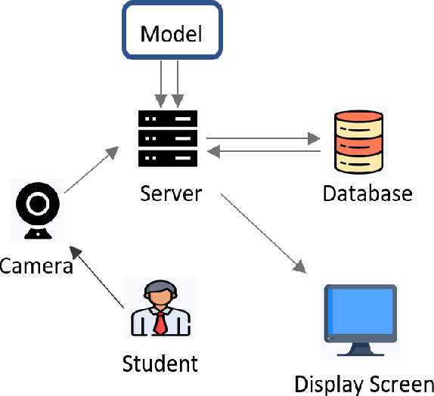
ARCHITECTURE

Slide 14
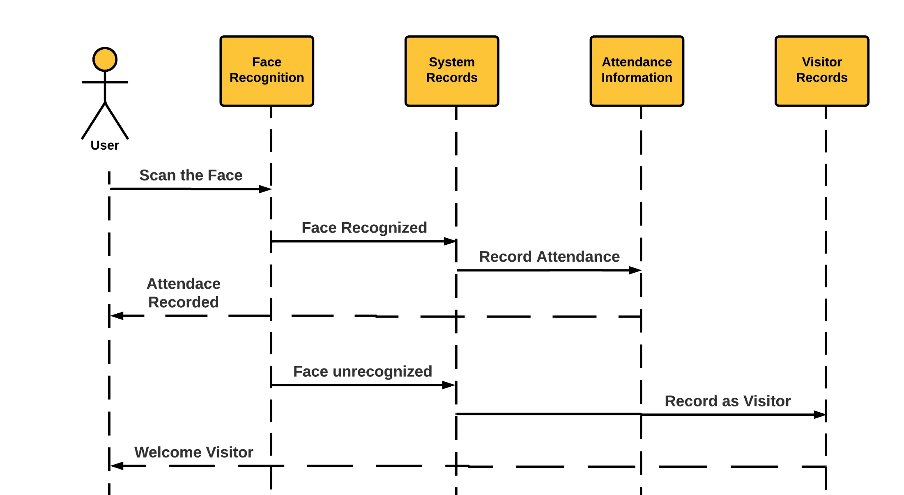
SEQUENCE DIAGRAM

Slide 15
IMPLEMENTATION:
The Facial recognition Attendance system is implemented involves several steps:
Data Collection and Enrollment:
Capture facial images or video footage of individuals who will be enrolled in the system.
Store the templates along with relevant information such as user ID and name.
Real-Time Face Detection:
Continuously capture images or video frames from a camera feed.
Apply face detection algorithms to locate faces within the captured images or frames

Slide 16
Face Recognition:
Perform face recognition on the detected faces using the enrolled templates.
Compare the captured face with the enrolled templates to determine if there is a match.
Assign an identity to the recognized face based on the matched template.
Face recognition process can be divided into three steps prepare training data, train face recognizer, prediction. Here training data will be the images present in the dataset.
During Face recognition process histogram of the face to be recognized is calculated and then compared with the already computed histograms and returns the best matched label associated with the student

Slide 17
Attendance Updation:
Record the attendance details of recognized individuals, name, and timestamp.
After face recognition process, the recognized faces will be marked as present in the excel sheet and the rest will be marked as absent and the list of absentees will be mailed to the respective faculties.
Faculties will be updated with monthly attendance sheet at the end of every month.

Slide 18
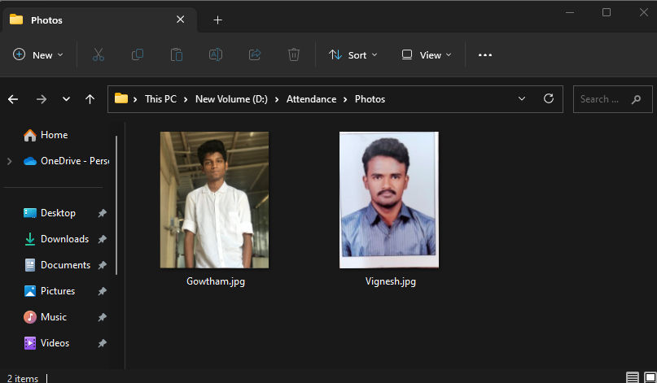
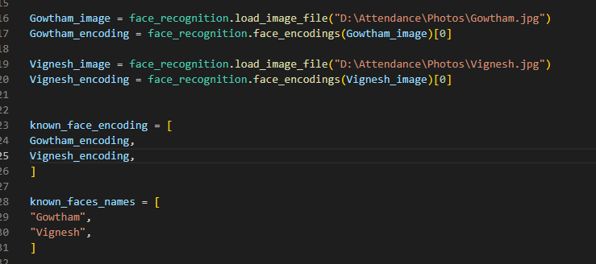
ADDING INFORMATION ABOUT CLIENTS:
This database stores the data about the clients/students who enrolled individuals' facial information ,names.

Slide 19

LOGIN PAGE:
The administrator login is used to configure the attendance system according to the specific requirements of the organization. This may include setting up working hours, defining attendance rules, managing user roles and permissions, and customizing various system settings.

Slide 20
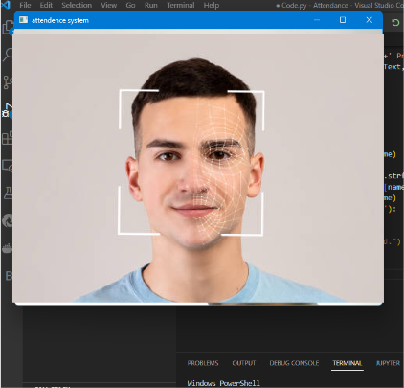
FACE DETECTION POPUP:
The face recognition process begins with face detection, where an algorithm locates and extracts facial features from an image or video frame. This step involves identifying regions of an image that potentially contain faces.

Slide 21
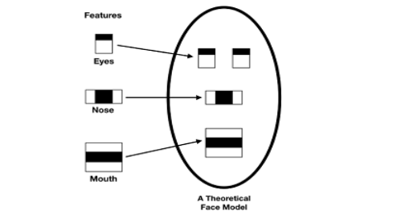
FACE ANALIZATION
It works by identifying and measuring facial features in an image. Facial recognition can identify human faces in images or videos, determine if the face in two images belongs to the same person, or search for a face among a large collection of existing images.

Slide 22
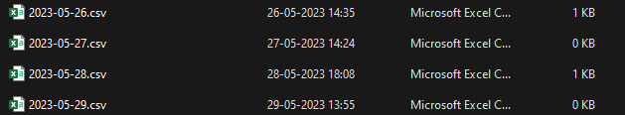
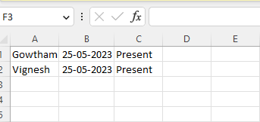
Attendance Updation
After face recognition process, the recognized faces will be marked as present in the excel sheet and the rest will be marked as absent and the list of absentees will be mailed to the respective faculties.

Slide 23
REFERENCE:
[1] Hapani, Smit, et al. "Automated Attendance System Using Image Processing." 2018 Fourth International Conference on Computing Communication Control and Automation (ICCUBEA). IEEE, 2018.
[2] Akbar, Md Sajid, et al. "Face Recognition and RFID Verified Attendance System." 2018 International Conference on Computing, Electronics & Communications Engineering (iCCECE). IEEE, 2018.
[3] Okokpujie, Kennedy O., et al. "Design and implementation of a student attendance system using iris biometric recognition." 2017 International Conference on Computational Science and Computational Intelligence (CSCI). IEEE, 2017

Slide 24
REFERENCE
. [4] Rathod, Hemantkumar, et al. "Automated attendance system using machine learning approach." 2017 International Conference on Nascent Technologies in Engineering (ICNTE). IEEE, 2017.
[5] Siswanto, Adrian Rhesa Septian, Anto Satriyo Nugroho, and Maulahikmah Galinium. "Implementation of face recognition algorithm for biometrics based time attendance system." 2014 International Conference on ICT For Smart Society (ICISS). IEEE, 2014.
[6] Lukas, Samuel, et al. "Student attendance system in classroom using face recognition technique." 2016 International Conference on Information and Communication Technology Convergence (ICTC). IEEE, 2016.

Slide 25
THANK YOU

